Slide 1
PRODUCT RECCOMENDATION SYSTEM
Team Id-3711
College Name-Shree Swaminarayan Institute of technology
Team Leader- Shivam Kumar
Members-
1)DEVANSHU PARMAR
2)SAHIL PATEL 3)NIRAV KATHAROTIYA 4)HARSH PACHANI

Slide 2
AGENDA
To reduce the CAC(Customer Acquisition Cost)
predict users' interests and recommend product items that quite likely are interesting for them
A system which predicts ratings a user might give to a specific item.

Slide 3
PROBLEM STATEMENT
Product recommendation to customers based on their interests, needs, and past behavior. The goal of product recommendation is to help customers discover new products that they might be interested in purchasing, and to help businesses increase their sales by suggesting relevant products to customers.
The goal of product recommendation is to help customers discover new products that they might be interested in purchasing, and to help businesses increase their sales by suggesting relevant products to customers.
Reference : https://pure-good-heroes.fandom.com/wiki/WALL-E

Slide 4
PROJECT OVERVIEW
The goal of product recommendation is to help customers discover new products that they might be interested in purchasing, and to help businesses increase their sales by suggesting relevant products to customers.
Product recommendation system use machine learning algorithms to analyze user behavior and preferences, such a system can make personalized recommendations to each individual user, based on their specific interests and needs. The pipeline of a recommendation system has the following five phases 1).Pre-processing 2).Model Training 3).Hyper Parameter Optimization 4).Post Processing 5).Evaluation.

Slide 5
WHO ARE THE END USERS?
Firstly we are targeting small case businesses and startups who have high customer acquisition cost. So they have high burn ratio because of not having right team and support for how to reduce CAC and so we are targeting them so they can reduce that ratio and make profitable business. We will analyze their data and give accurate result and recommendation through our ML algorithm so that they can target most similar user according to their product and requirement.
And after we are targeting users to give them better price and product according to their requirement and we are also trying to suggest them that which product that they can try from our side from their past purchase history.

Slide 6
THE WOW FACTOR IN OUR SOLUTION
Product recommendation system use machine learning algorithms to analyze user behavior and preferences, such a system can make personalized recommendations to each individual user, based on their specific interests and needs and it can continuously improve its recommendations, making them more accurate and relevant over time .In this We are using some specific machine learning algorithm to give the Best accuracy:
K-NN algorithm
SVM
Collaborative Filtering
Decision Tree(Specified for the best accurate result)

Slide 7
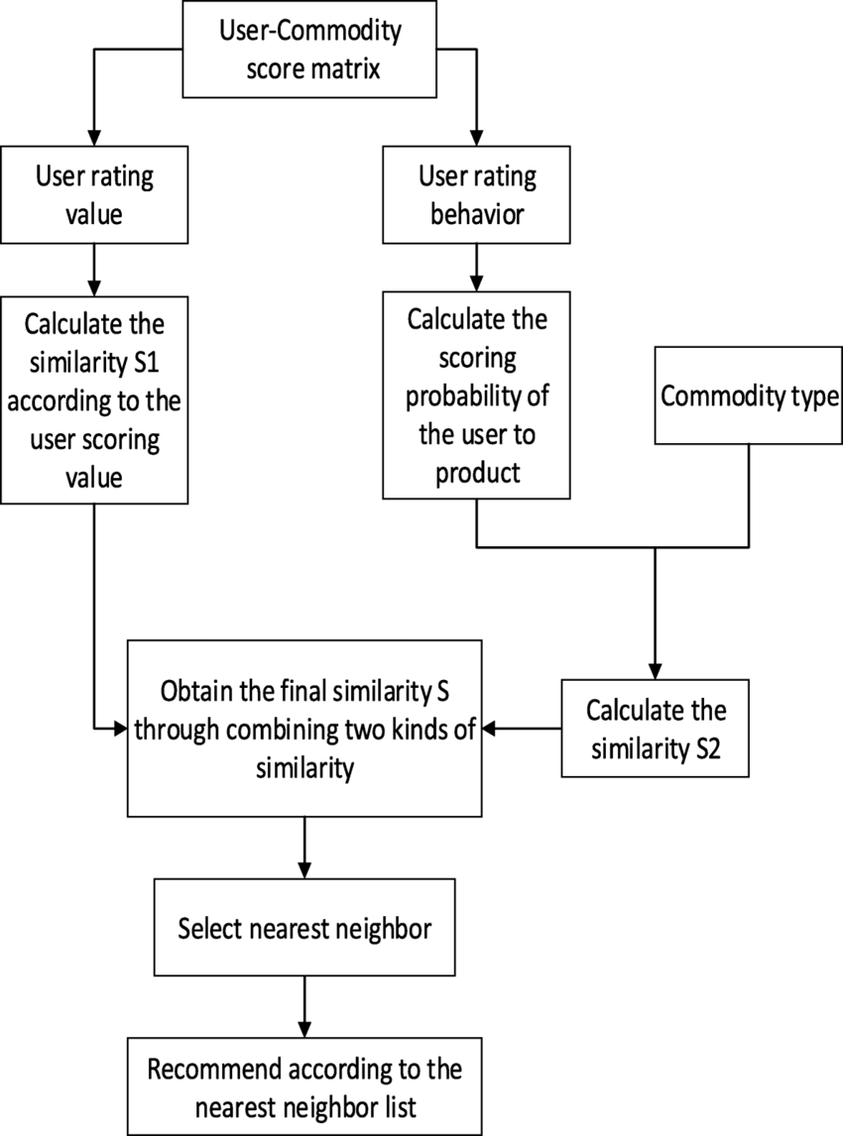
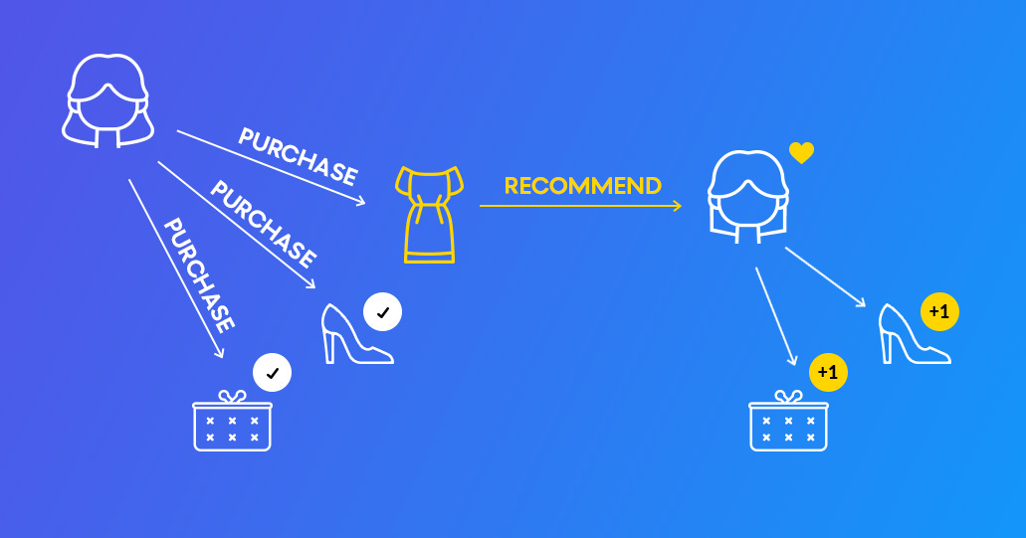
MODELLING

Slide 8
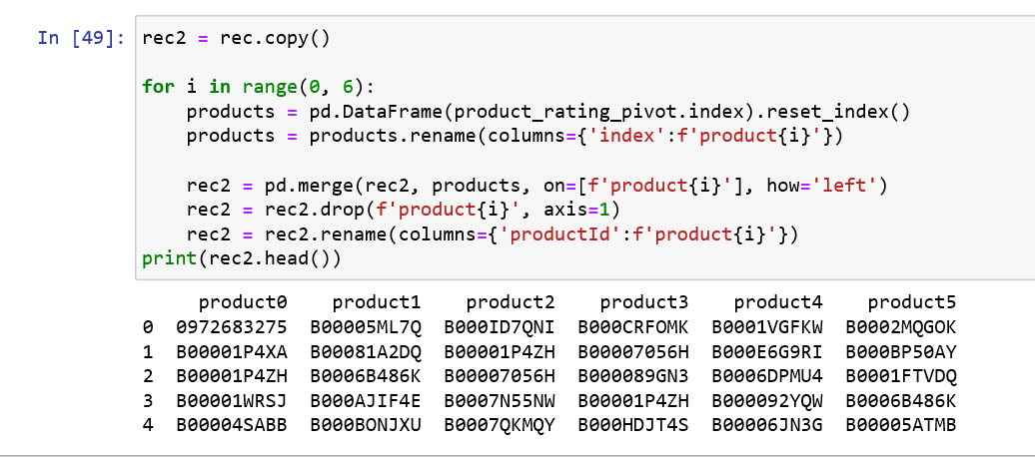
RESULTS
Once all this process is completed, we train our model on the dataset. The model will now be able to predict different products for the users. In the given table we can see the results which contains the Product id’s that are finally recommended to the user by the Recommender System.

Slide 9

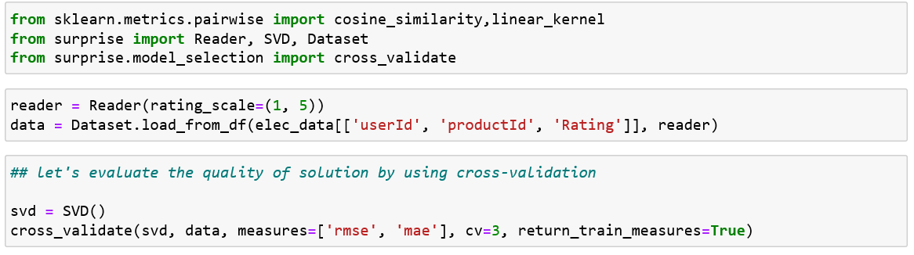
ACCURACY
Demo/Github Link :https://github.com/nirav0412/Product_Reccom_System.git

Slide 10
CONCLUSION
The primary goal of this project is to provide recommendations to the user in a e-commerce website by making use of machine learning algorithms. We have designed and implemented the system using collaborative filtering and Pearson correlation coefficient. The dataset considered has the ratings given by the other users to a specific product and depending on the similarity between the rated product we try to recommend the products to our current user. The future work of the project includes improving the efficiency of the system. And it should also be able to give appropriate recommendations to the users who don’t have any previous purchase history or to the new users. In future we can try to use recurrent neural networks and deep learning. With the help of deep learning techniques we can overcome some of the drawbacks of the matrix factorization technique.

Slide 11



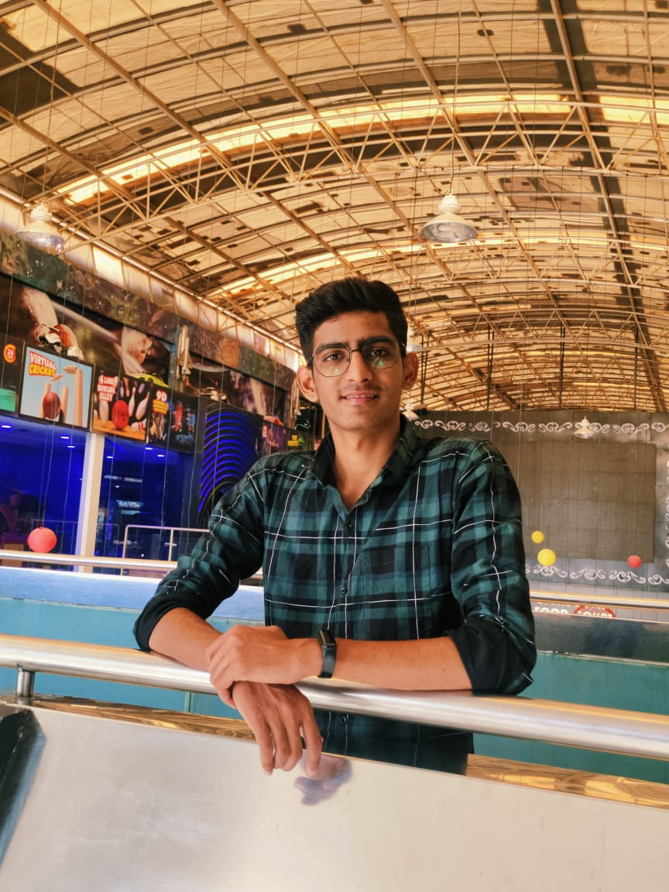

MEET OUR TEAM
Devanshu Parmar
Nirav Katharotiya
Sahil Patel
Harsh Pachani
Shivam Kumar

